Slide 1
MGT 388 Finance and Law for Engineers
Lecture 3
Accounting regulation. Cash vs Profit.
The role of Financial Accounting, Management Accounting and Financial Management

Slide 2
Learning Outcomes
At the end of this lecture, students should:
Understand in outline the sources of Accounting rules.
Identify the basic objective of Accounting information and the Assumptions of Financial Statements.
Distinguish Profit and Cash.
Understanding the revenue recognition and the matching principle.
Understand the Statement of Cash Flows.
Understand the role of Financial Accounting, Management Accounting, and Financial Management.

Slide 3
Limited Company
It is an artificial person created by law
It has a separate life to its owners and is granted a perpetual existence
It must take responsibility for its own debts and losses, but its owners are granted limited liability
To protect those dealing with it, limited liability is included in the name, restrictions are places on the withdrawal of equity and annual financial statements are made publicly available
A public company can offer its shares for sale to the public; a private company cannot
It is governed by a board of directors, which is elected by the shareholders
The UK Corporate Governance Code sets out how a Stock Exchange listed company should be directed and controlled.
Atrill, McLaney, Accounting and Finance for non-specialists, 11th Edition, Pearson.

Slide 4
Accounting Regulation
Types of Companies
Private company – minimum of one director and one shareholder – described as ‘limited’ or ‘ltd’.
Public company – described as ‘public limited company’ or ‘plc’ – must have share capital of at least £50 000.
Only plcs may be listed on a Stock Exchange, but not all plcs are listed.
Gowthorpe – Business Accounting and Finance, 4th edition, Cengage.

Slide 5
Accounting Regulation
Companies Acts (since mid 19th century) – latest is the CA 2006.
CA 2006 contains regulation about e.g.
  Formation of new companies and types of company
  Issue of shares
  Role of directors
  Audit
  Publication and presentation of accounting information.
Gowthorpe – Business Accounting and Finance, 4th edition, Cengage.

Slide 6
Accounting Regulation
Accounting Requirements
Accounting standards – in the UK issued by the Financial Reporting Council (FRC) – these are Financial Reporting Standards (FRS).
International Financial Reporting Standards (IFRS) – issued by the International Accounting Standards Board (IASB). Listed companies in UE must comply with IFRS.
In the UK, the authority of the IASB extends only to listed companies. However, non-listed UK companies have the option to adopt IFRSs.
Gowthorpe – Business Accounting and Finance, 4th edition, Cengage.

Slide 7
Accounting Regulation
The Financial Conduct Authority (FCA) is the listing authority in the UK and imposes additional rules on Stock Exchange listed companies.
Listing regulations for quoted companies – London Stock Exchange is highly regulated – additional accounting requirements e.g. interim accounting requirements (interim reports prepared for six-month periods).
Annual report – minimum accounting requirements plus additional voluntary disclosures.
Gowthorpe – Business Accounting and Finance, 4th edition, Cengage.

Slide 8
Accounting Regulation
Shareholders elect a qualified and independent person or, more usually, a firm to act as auditors.
The main duty of auditors is to report whether, in their opinion, the financial statements show a true and fair view of the financial performance, position and cash flow of the company.
The auditors’ opinion must accompany the financial statements sent to shareholders and to the Registar of Companies.
Gowthorpe – Business Accounting and Finance, 4th edition, Cengage.

Slide 9
Basic Objective
To provide financial information about the reporting entity that is useful to present and potential equity investors, lenders, and other creditors in making decisions about providing resources to the entity.
  Provided by issuing general-purpose financial statements.
  Assumption is that users need reasonable knowledge of business and financial accounting matters to understand the information.
Gowthorpe – Business Accounting and Finance, 4th edition, Cengage.

Slide 10
Assumptions
Economic Entity – company keeps its activity separate from its owners and other business unit.
Going Concern - company to last long enough to fulfill objectives and commitments.
Monetary Unit - money is the common denominator.
Periodicity - company can divide its economic activities into time periods.
Accrual Basis of Accounting – transactions are recorded in the periods in which the events occur.
Kieso, Weygandt, Warfield: Intermediate Accounting, IFRS Edition, Wiley.

Slide 11
Revenue recognition and matching principle
  Revenue recognition is an aspect of accrual accounting that stipulates when and how businesses “recognise” or record their revenue.
  The principle requires that businesses recognise revenue when it is earned (accrual accounting) rather than when payment is received (cash accounting).
  Realised revenue means that goods or services have been received by the customer, but payment for the good or service is expected later.
  Matching principle: costs are determined according to the sales to which they relate, so there is a timing difference between recognition and cash flow. This difference appears in the ‘balance sheet’ as a liability or an asset.

Slide 12
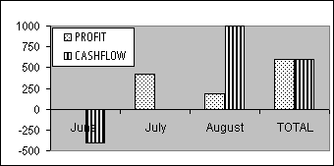
Revenue recognition and matching concept
An item sells for $10; bought for $4; profit $6
In June, a business purchases 100 from a supplier for cash;
in July, 70 are sold on a month’s credit to a customer;
in August, the remaining widgets are sold for cash.
STOCK
100
30
0

Slide 13
Depreciation
  The term depreciation refers to an accounting method used to allocate the cost of a tangible or physical asset over its useful life. Depreciation represents how much of an asset's value has been used. Depreciation ties the cost of using a tangible asset with the benefit gained over its useful life.
There are many types of depreciation, including straight-line and various forms of accelerated depreciation.
Accumulated depreciation refers to the sum of all depreciation recorded on an asset to a specific date. The carrying value of an asset on the balance sheet is its historical cost minus all accumulated depreciation. The carrying value of an asset after all depreciation has been taken is referred to as its salvage value.
  Depreciation can be compared with amortisation, which accounts for the change in value over time of intangible assets.

Slide 14
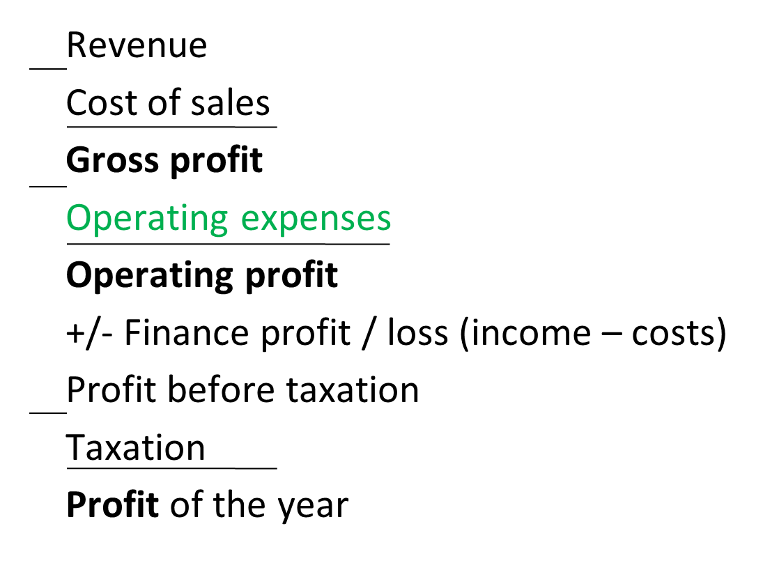
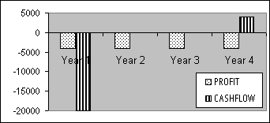
Depreciation
A delivery van is bought for $20,000 and is expected to have a useful life of 4 years, at which time it will be sold for $4,000.
The depreciation on the van is thus expected to be $16,000 or $4,000 per year. This annual cost contrasts with cash flows which only occur on purchase and disposal. The difference between the two figures is the depreciated value of the asset:
  $16000 at the end of year 1
  $12000 at year 2
  $8000 at year 3
  zero at year 4
Over the four years, which is a long term,
the depreciation cost is the same as
the cash outflow.

Slide 15
Statement of Cash flows
‘Money’ in notes, coin or digital form
  ‘in hand’, ‘at bank’ account, as ‘bitcoin’
Cash ‘balance’ is at a moment in time
  Closing CASH balance = Opening CASH balance +/- CASHFLOW
CASHFLOW = RECEIPTS – PAYMENTS
    Cash flow occurs over a period of time
Possession provides ‘liquidity’
Having cash avoids ‘insolvency’

Slide 16
Statement of Cash Flows
Primary Purpose: To provide relevant information about the cash receipts and cash payments of an enterprise during a period.
Statement provides answers to the following questions:
  Where did the cash come from?
  What was the cash used for?
  What was the change in the cash balance?
Kieso, Weygandt, Warfield: Intermediate Accounting, IFRS Edition, Wiley.

Slide 17
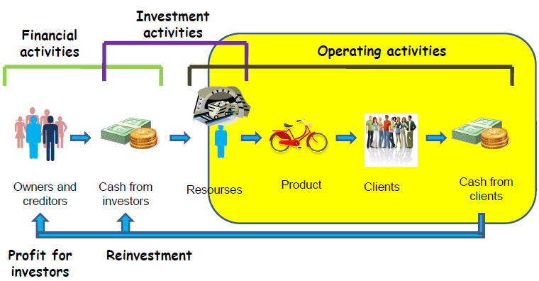
Transformation Process

Slide 18
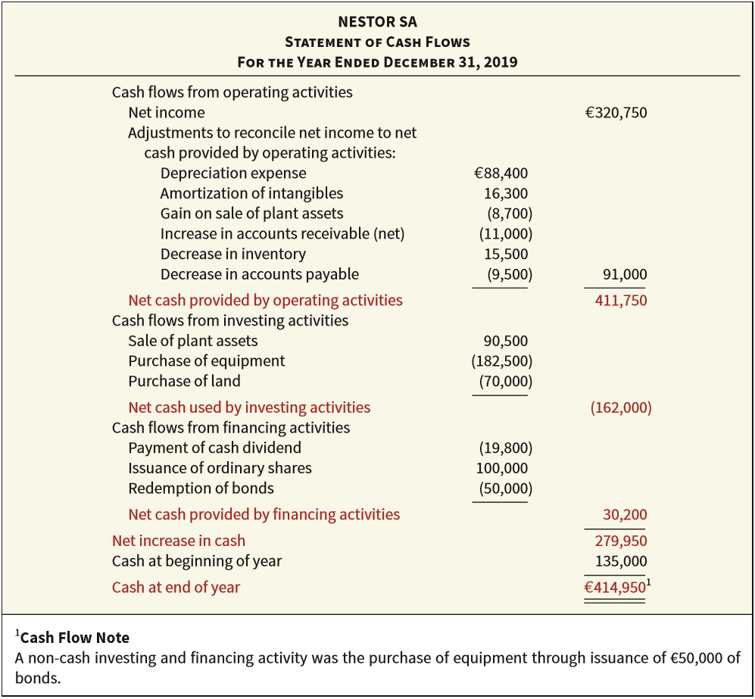
Statement of Cash Flows
ILLUSTRATION 5.24
Comprehensive Statement
of Cash Flows
Kieso, Weygandt, Warfield: Intermediate Accounting, IFRS Edition, Wiley.

Slide 19
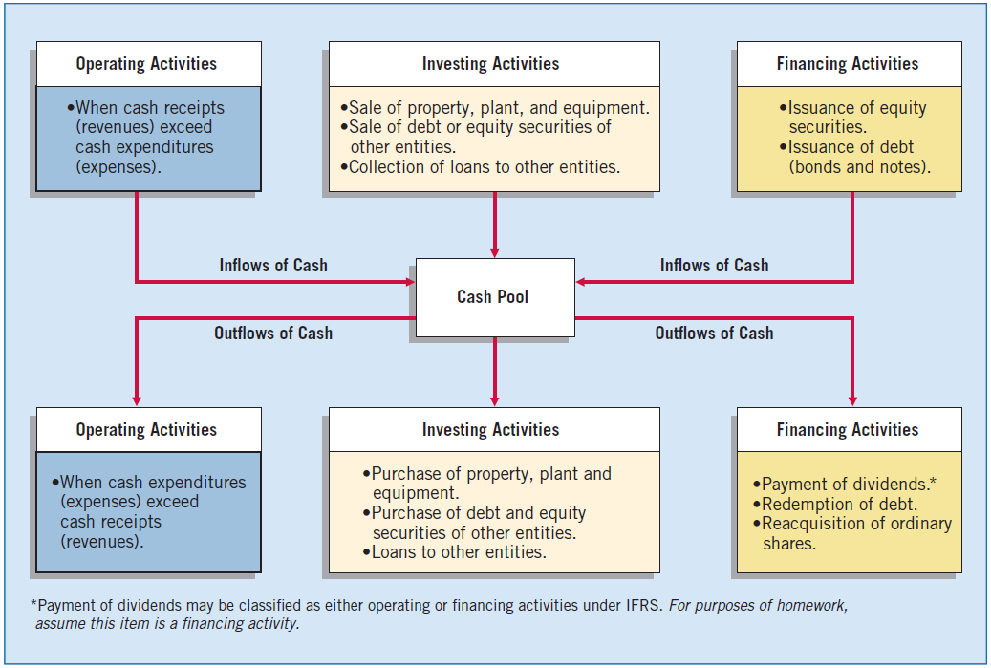
Statement of Cash Flows
ILLUSTRATION 5.19
Cash Inflows and Outflows
Kieso, Weygandt, Warfield: Intermediate Accounting, IFRS Edition, Wiley.

Slide 20
What is Accounting?
Regulation
Collect
Financial information
Analyse
Financial information
Communicate
Non-financial information
Non-financial information
To allow users
Decision making
  what information?
  where does it come from?
  to whom is it disclosed?
  why does it need to be ‘assured’? can it be?
  what is the nature of the decisions it serves?
  Accounting is an organizational process
Bamber, Matt & Parry, Simon, 2020. Accounting and Finance for Managers, London: Kogan Page, Limited.

Slide 21
What is Finance?
How / Why to acquire?
Money needed / Capital
How to spend / invest?
what business purposes?
  cash for investing in business infrastructures
    physical, human, natural & social capital
  cash to support its operation
    working capital
  the providers of finance require reward
Finance is a resource

Slide 22
Financial Accounting
“the accounting process and database required to generate published periodic financial reports as regulated by law, accounting & reporting standards”
based mainly on historic, external transactions
represent the accountability of the board of directors
  as ‘stewards’ to shareholders
  but is their a wider obligation to society?
financial accounting is the regulated part of accounting

Slide 23
Management Accounting
process of acquiring, analysing, & presenting information designed to monitor organisational performance & support management in the taking of decisions
  unregulated
  customised to user & context
  contemporary & forward-looking
  contains non-financial data
management accounting is accounting for the benefit of management

Slide 24
Financial and Management Accounting
 | FA | MA
Nature of the reports produced | General-purpose | Specific-purpose (often)
Level of detail | Broad overview | Considerable detail
Regulations | Subject to accounting regulations | No specific regulation
Reporting interval | Annual basis (often) | As frequently as required
Time horizon | Backward-looking | Backward + Forward-looking
Range and quality of information | Financial information | Financial + non-financial information

Slide 25
Financial Management
Financial management is a combination of management accounting and finance:
Balancing profitability with risk exposure with the aim of enhancing corporate value
The dividend and/or distribution decisions
Making strategic investment decisions
Selecting and reviewing sources of finance, the obtaining of capital.
Bierman, H., 2010. An introduction to accounting and managerial finance: a merger of equals, Singapore ; Hackensack, NJ: World Scientific.

Slide 26
Your Reading (optional)
Gowthorpe:
Chapters 2, 3, 4.2 (accounting conventions), 4.3 (comprehensive example of accruals), 6 and 7.

